Slide 1
CSSE 332 Producer and Consumer
Condition Variable II

Slide 2
Outline
Producer and Consumer problem with condition variable
Materials:
http://pages.cs.wisc.edu/~remzi/OSTEP/threads-cv.pdf
https://en.wikipedia.org/wiki/Producer%E2%80%93consumer_problem

Slide 3
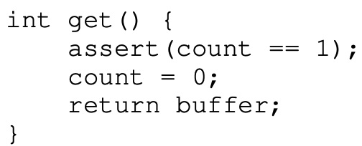
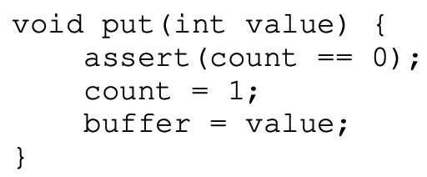
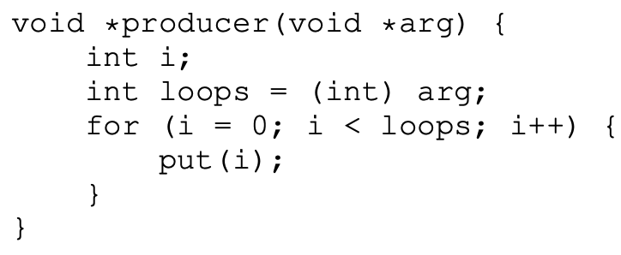
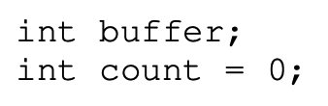
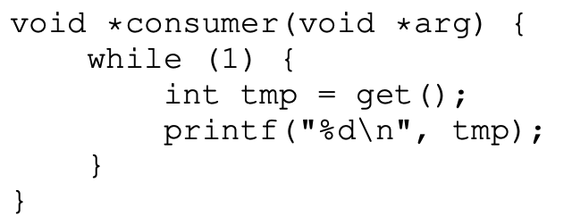
Problem Set up
Producer/Consumer (a.k.a., Bounded Buffer)
Given a buffer with certain size, use 1 here
Consumer(s) can consume item(s) with get()
Producer(s) can fill item(s) with put(value)
Initial:

Slide 4
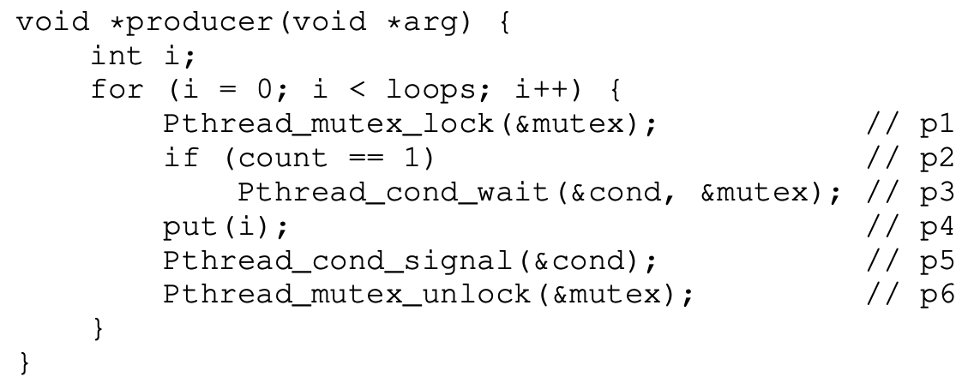
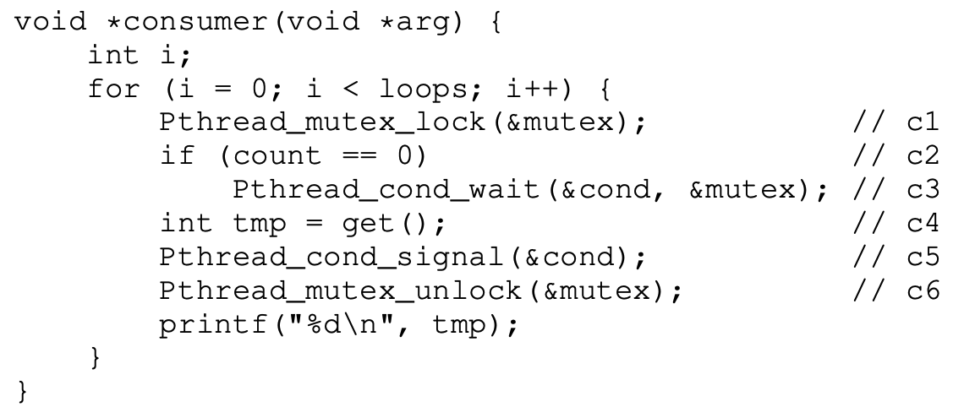
Solution #1
Problem?

Slide 5
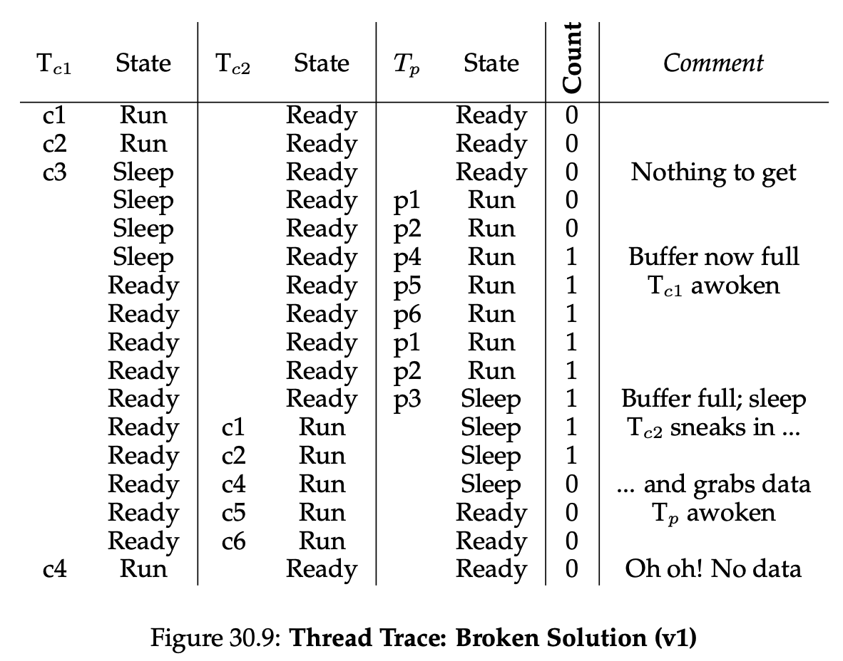
If statement doesn’t work

Slide 6
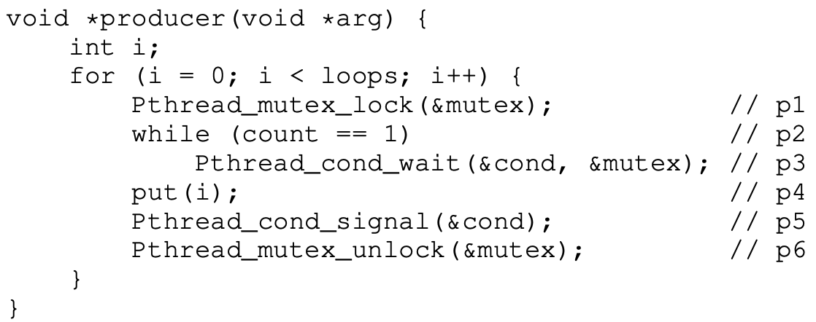
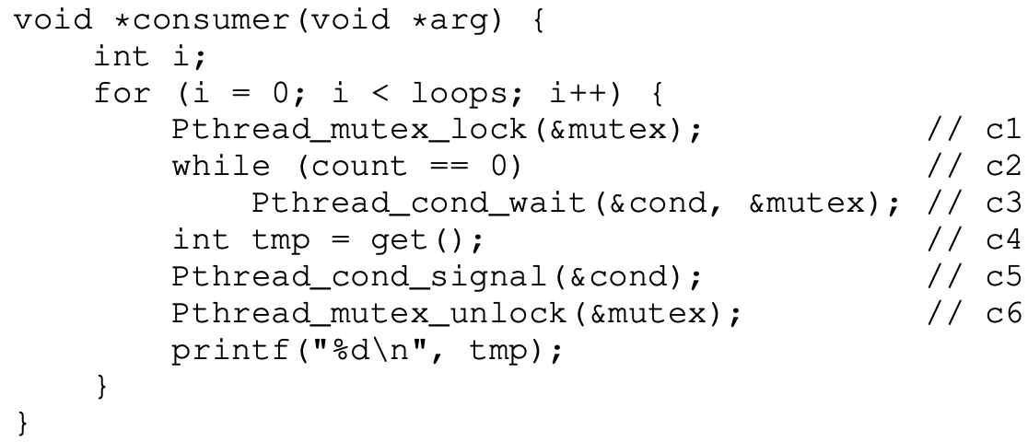
Solution #2
Problem?

Slide 7
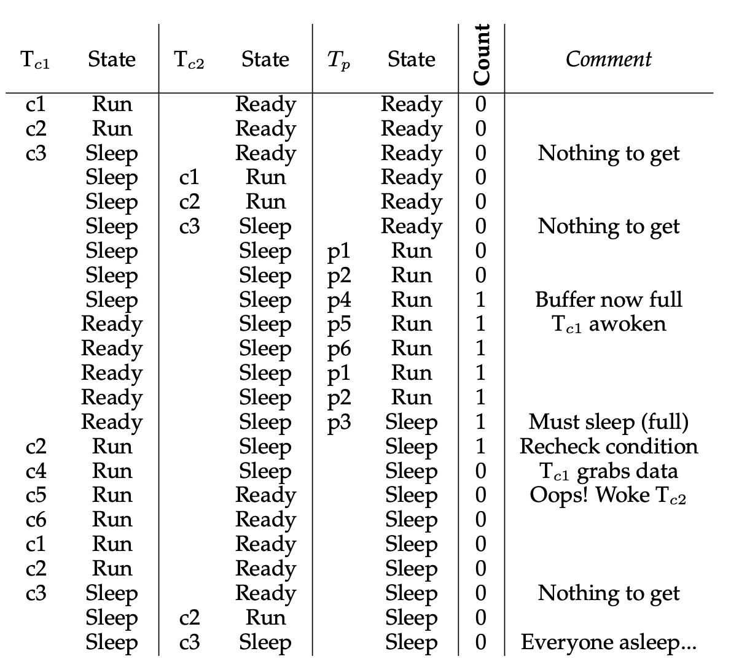
Wake up the wrong thread

Slide 8
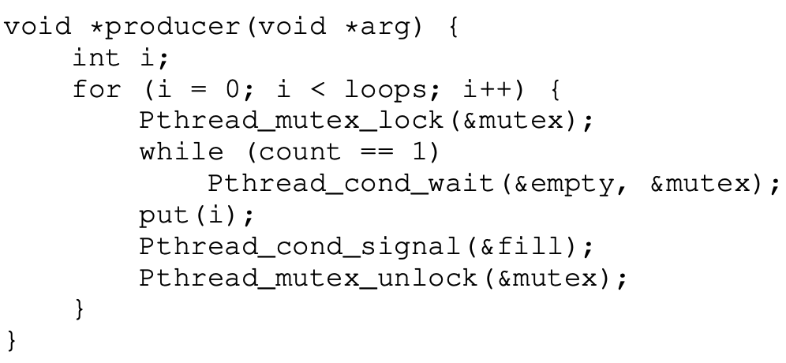
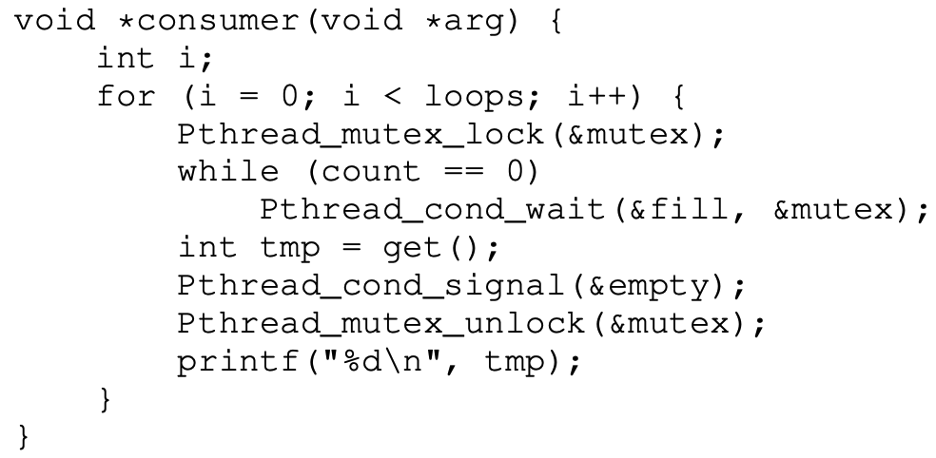
Correct Solution
Two CVs And While

Slide 9
Activity
Extend the solution to a Single Buffer (not one item)

